Slide 2
CI from scratch
How I stopped worrying and started to love the automatic test

Slide 3
Nexer r&d
We are Technical Problem Solvers with a passion for challenges.
We turn ideas into reality through agile teams that develop software for high-tech products.
We have a strong community, and we help each other to develop.
Our employees are our heroes and work in exciting assignments developing the latest technology.
We have sites in Göteborg, Stockholm and Linköping

Slide 4





MANASA
DAVID
NIKOLAI
NEXER R&D Consultants
We are DevOps consultants working towards
maintaining and developing the Big CI at Ericsson

Slide 5
What you will learn
Main functions of Gerrit and Jenkins UI
Setting up a Basic CI-flow in Jenkins
Potential pitfalls with a CI-flow
Setting up a big CI
Parallelism
Smart testing
Disclaimer: This presentation is based on my experience

Slide 6

Gerrit code review
Used to review code
Open source
Repository manager
Integrates well with user management servies
Plugins for most services
Integrates well with Jenkins

Slide 7

Jenkins
Open source CI/CD engine.
Customisable to your preference with plugins
Integrates with most technologies
Bases everything on Jenkins jobs
Jenkins master/nodes
Large community
Pipeline as code

Slide 8
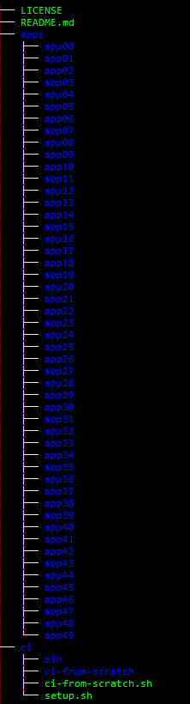
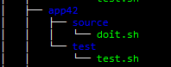
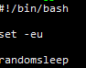
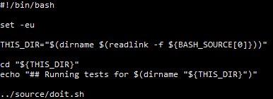
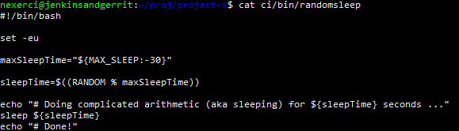
Our repository
Script for each app
Tests for each script
50 parts of applications
Each script sleeps a random amount of time

Slide 9




Basic CI-flow
Gerrit
Commits
SSH/HTTPS
Listen for changes and provides feedback
Reviews
Runs tests/jobs

Slide 10
Basic CI Jenkins job
– Run all tests
Checkout commit
Find All Tests
Build/Run Tests
Report status to user

Slide 11
Basic CI Jenkins job
– Run all tests
Checkout commit from Gerrit
Find All Tests
Build/Run Tests
Report status to Gerrit

Slide 12

Basic CI Jenkins job
– Run all tests
Benefits
Problems
Scales (badly)
Test assurance
Incredibly slow
Hogging resources
Blocking user

Slide 13
Big CI
1. Parallelism
Enables running many tests
2. Build avoidance / caching
Don’t rebuild source/objects that have not changed
Cache objects/build dependencies between consecutive runs
3. Smart testing
Many tests→running all cripples CI
Only run tests that are related to change
4. Invest in Application and CI architecture
Design for testability
Divide application into sub responsibilities (modularization)
Communicate with backwards compatible interfaces

Slide 14
Big CI
1. Parallelism
Enables running many tests
2. Build avoidance / caching
Don’t rebuild source/objects that have not changed
Cache objects/build dependencies between consecutive runs
3. Smart testing
Many tests→running all cripples CI
Only run tests that are related to change
4. Invest in Application and CI architecture
Design for testability
Divide application into sub responsibilities (modularization)
Communicate with backwards compatible interfaces
Separation of concerns!

Slide 15
Testability and modularization
Script for each app
Tests for each script
50 parts of applications

Slide 16
Parallelism
Run multiple tests at the same time
Use the nodes and executors in Jenkins
Test1
Main job
Test5
Test2
Test3
Test4
Node 1
Node 2
Executor 1
Executor 2
Executor 3
Executor 4
Executor 5

Slide 17
Smart testing
Find what files has changed
Run tests on only the changed applications
Git diff
Find changed apps from diff
Run tests of apps

Slide 18
Questions?

Slide 20
Thank you
nikolai.dahlberg@nexergroup.com
saitejomanasa.konda@nexergroup.com
david.spangberg@nexergroup.com

